Slide 1
Building daily CalLite model from scratch – daily version

Slide 2
Goals
Learn how to rebuild CalLite schematic North of Delta model from scratch using daily data
Including Delta operations and requirements will be saved for later
Review how WRESL routes water without actual channel routing like Muskingum method
Determine the validity and corroborate the results

Slide 3
North of Delta Daily 1-year model
Time period
August 2019-August 2020 (mostly water year 2020)
Progresses as phases and sub-phases which can be done on parallel paths
Feather River to Confluence
Yuba River to Confluence
Feather-Yuba to SacFeather confluence
Shasta to Red Bluff
Trinity to Red Bluff
Shasta-Trinity to SacFeather confluence

Slide 4
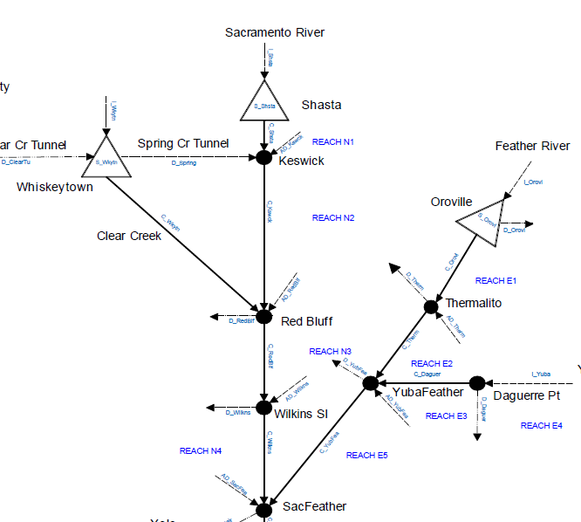
Schematic

Slide 5
Questons
What is the philosophy of using Accretion-Depletion (AD) terms?
How to estimate daily AD terms from available daily data?
Is it okay to estimate these terms using CDEC data or will I have to refer to CalSim II data?
With the

Slide 6
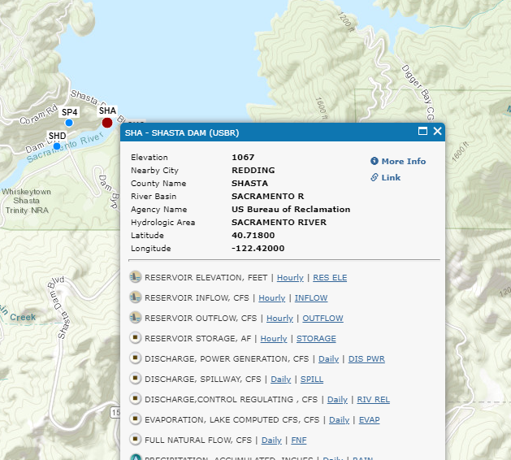
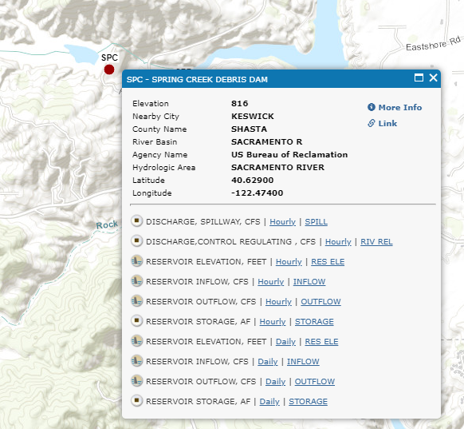
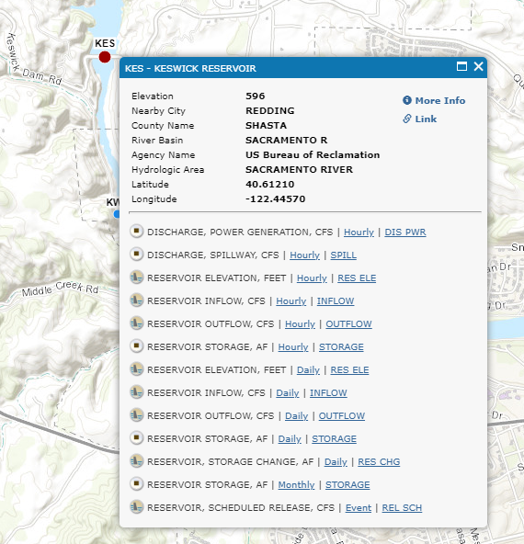
AD_KSWCK
Three components
Shasta dam (SHA) release
Inflow from Spring Creek (SPC)
Keswick dam release (KES)

Slide 7
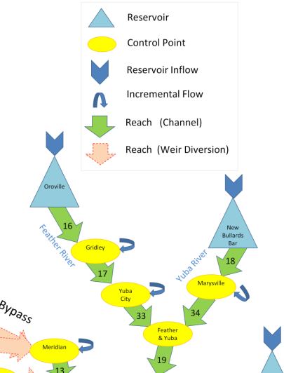
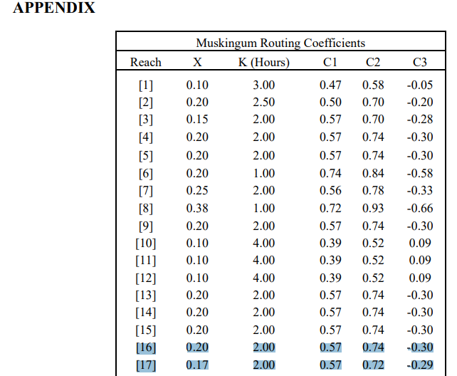
Connaughton (2014)
Sacramento Valley Integrated Reservoir Optimization Model (SVIROM): Flood Control linear program
Provided appendix with derived Muskingum routing coefficients
Reach 16 would be

Slide 8
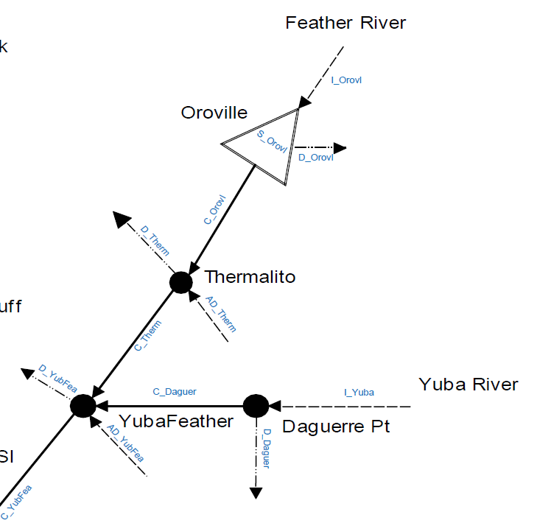
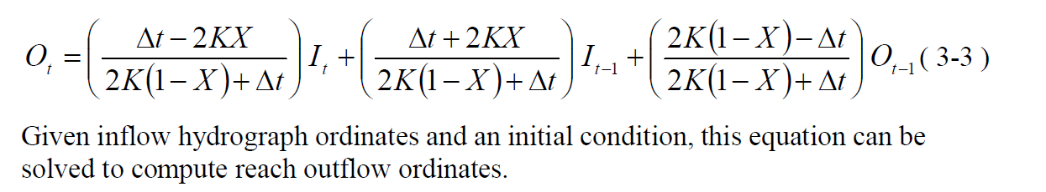
CalLite schematic
$$CTHERM=C_{0}COROVL+C_{1}COROVL\left(−1\right)+C_{2}CTHERM(−1)$$

Slide 9
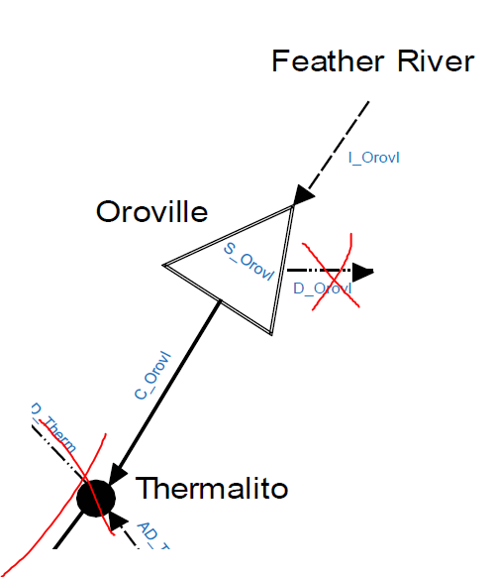
Phase 1.1 – Oroville dam and outflow only
Develop very simple model
Inflow to Oroville reservoir
Oroville reservoir storage
Release from Oroville storage
No deliveries/demands yet
Output
Daily Oroville releases

Slide 10
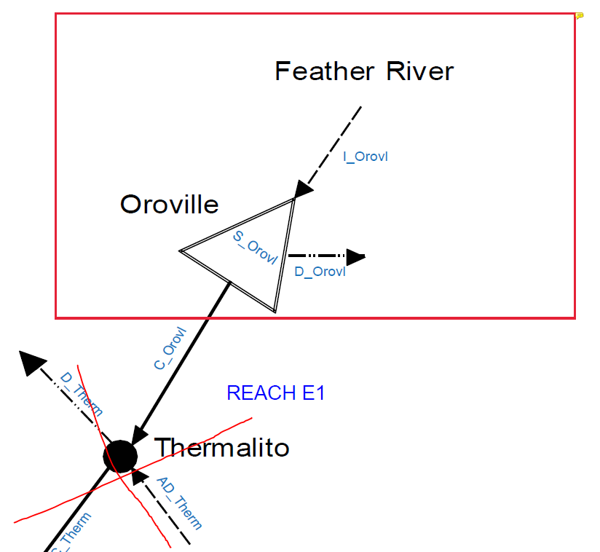
Phase 1.2 – Include Oroville deliveries
Include D_OROVL missing from previous step
Output
Oroville releases, storage, deliveries

Slide 11
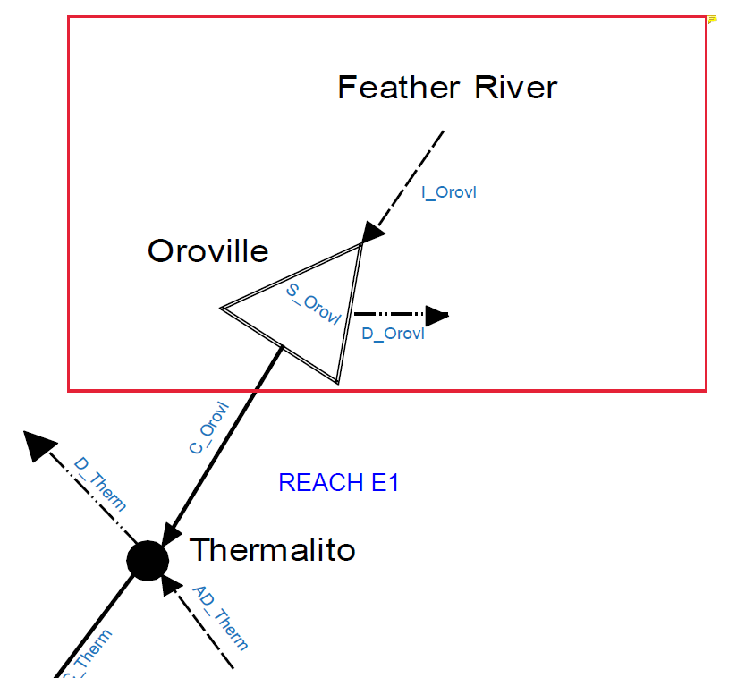

Phase 1.3 – Include Thermalito node
No deliveries yet
Just the passing of water from C_OROVL to C_THERM
Need to review the purpose of Accretion-Depletion (AD) terms and how to calculate
Output
Flow from Thermalito (C_THERM)

Slide 12
Phase 1.4 – Include Thermalito deliveries
Add demands for D_THERM
Need to review the purpose of Accretion-Depletion (AD) terms and how to calculate
Output
D_THERM

Slide 13
Phase 1 data requirements
Lake Oroville
Inflow (TAF/day)
Initial storage
Level 5 storage
Evaporation rate
Oroville water rights demands
Minimum groundwater pumping

Slide 14
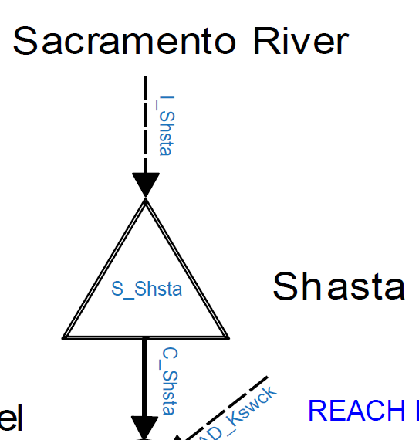
Phase 2.1 – Shasta dam and outflow only
Develop very simple model
Inflow to Shasta reservoir
Shasta reservoir storage
Release from Shasta storage
Output
Daily Shasta releases

Slide 15
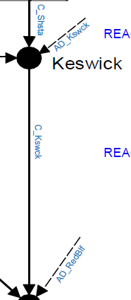
Phase 2.1 – Shasta dam and outflow only
Develop very simple model
Inflow to Shasta reservoir
Shasta reservoir storage
Release from Shasta storage
Output
Daily Shasta releases

